Slide 1


World
Staple Food Research
What are people in the world eating? (click)
Notes:
What is a staple food?
The staple food is the leading food that people use as the basis of their three meals daily and is represented mainly by carbohydrates such as grains and potatoes.
World's Three Great Grains and Others.
A stable supply is required for the staple food. About half of the world's population eat rice as their staple food in terms of population ratio. Other staple food is followed by wheat and corn, which are the world's three largest grains. Potatoes and soybeans are not the three major grains, but they are important staple foods. The United States and China mostly occupy significant grains, and the United States is also active in exports.

Slide 2
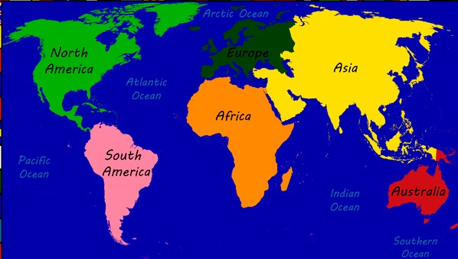
Let’s find What people in that area are eating?
Pacific Region
Click on the area on the map
Notes:
Countries without staple food.
Since rice is abundant in Asia, there is a concept of "rice = staple food for eating side dishes." However, people do not eat meat and vegetables to eat wheat = bread in Europe. Bread is by no means the main character in the diet. Europeans eat anything without the concept of staple food and side dishes, and there is a cultural background in which meat cannot be said to be a staple food. There is no fixed staple food in the United States due to the wide variety of races.

Slide 3
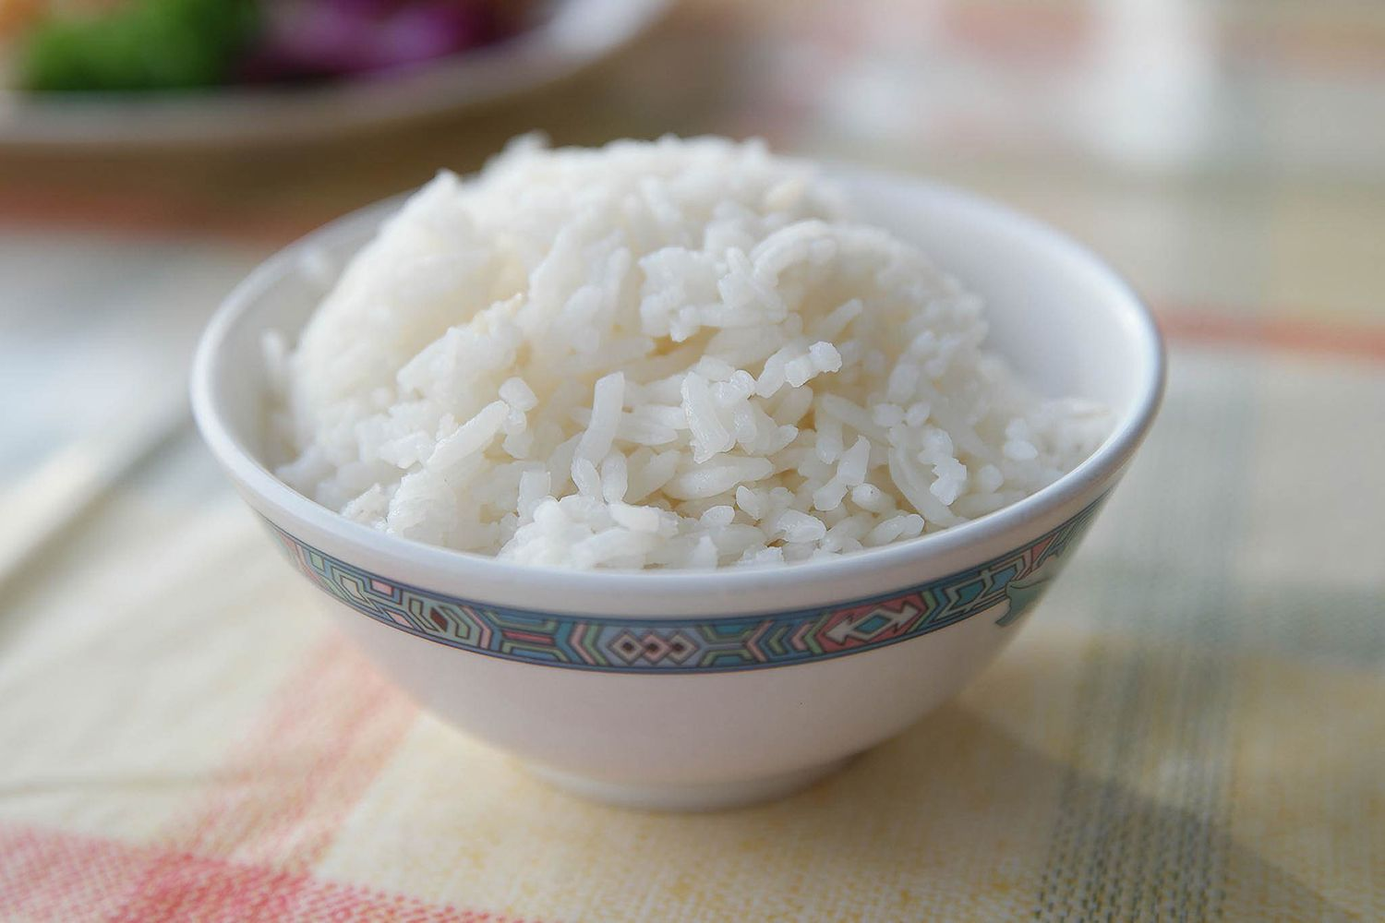
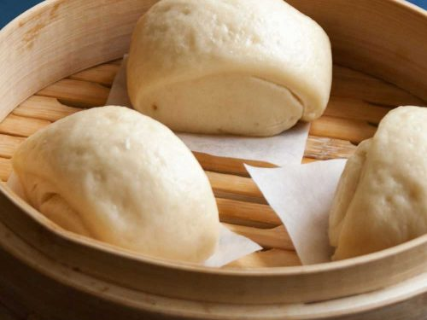
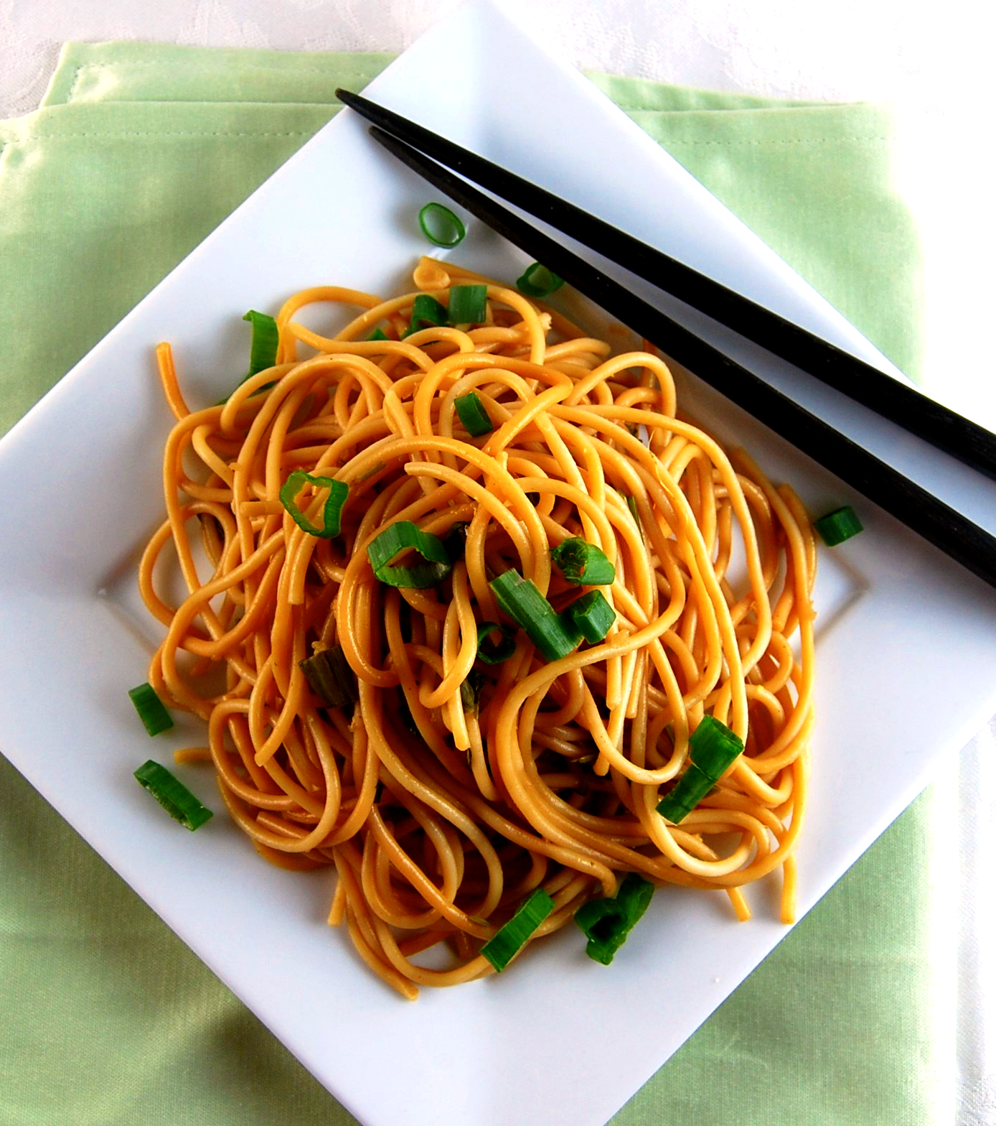
Asia
Rice
Wheat
Steamed Rice
Mantou
Noodle
Back to Map
Notes:
White steamed rice is the main character. There is a wide variety of wheat, including mantou that is steamed in dumplings, noodles that are thinly stretched and boiled, naan that is flat and baked, and chapati roti that is thinly stretched and baked without fermentation.

Slide 4
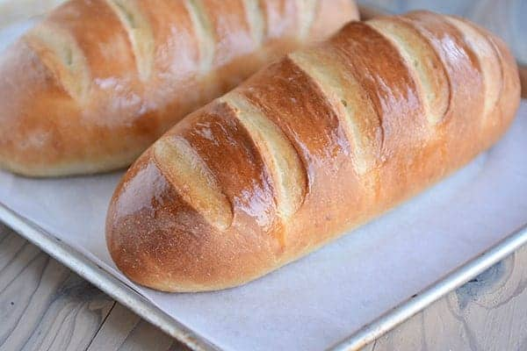
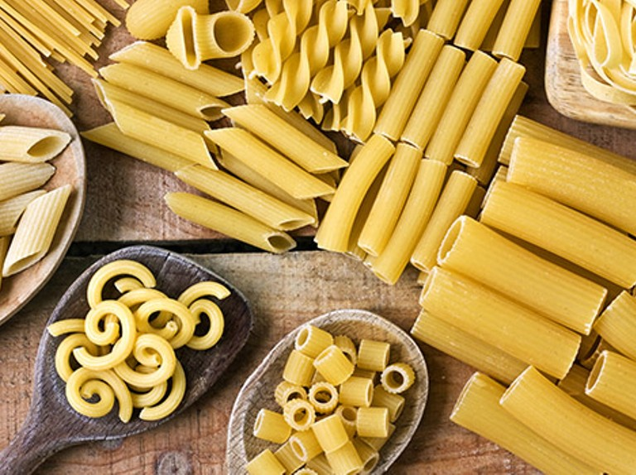
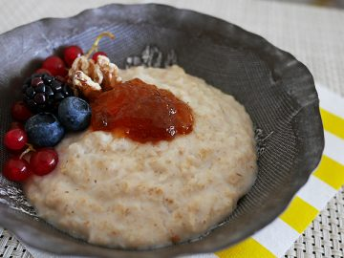
Europe
Wheat
Bread
Pasta
Porridge
Back to Map
Notes:
Of course, wheat is the main ingredient, and there is bread that has been fermented and baked, pasta that is boiled with water, and wheat porridge that is made by boiling wheat in a porridge shape.

Slide 5
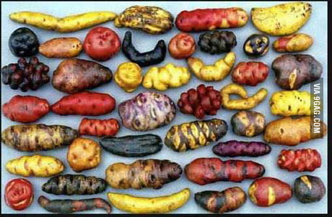

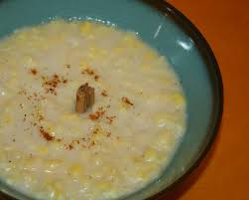
South America
Potato
Corn
Baked / Steamed Potatoes
Tortilla
Corn porridge
Back to Map
Notes:
There are tortillas that are ground corn, flattened, and baked. and roasted corn. In addition, there are corn porridge made by boiling corn as it is and roasted corn. Potatoes are eaten by steaming or baking.

Slide 6
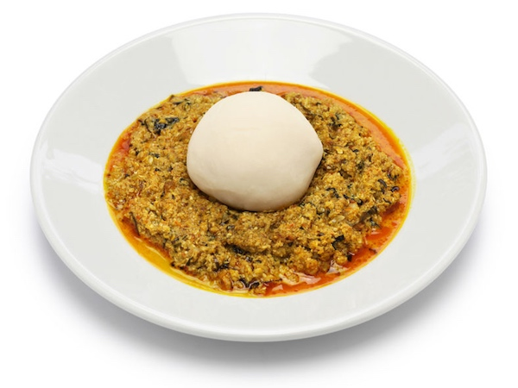
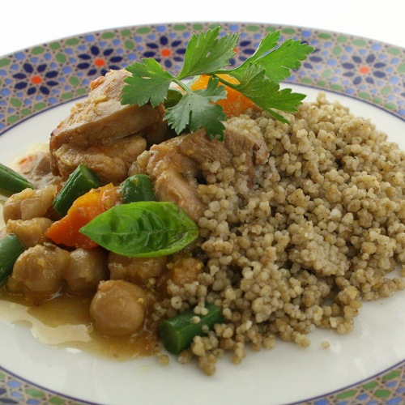
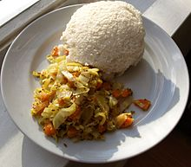
Africa
Yam potato
Millet
Fufu
Couscous
Ugali
Back to Map
Notes:
Mainly, Fufu is eaten. Cassava potatoes are crushed with a mortar and kneaded with hot water. Couscous is made by soaking coarsely ground durum wheat in water and rolling it into small grains with a size of about 1 mm after cooking. Ugali, which is made by grinding millet into powder and pouring hot water into it, is also a valuable staple food.

Slide 7
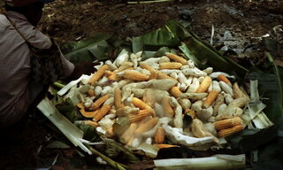
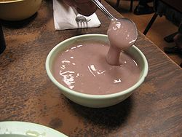
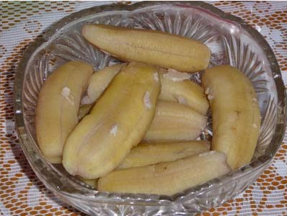
Pacific Region
Potatoes
Breadfruit
Banana
MuuMuu
Poi
Steamed Banana
Back to Map
Notes:
Potatoes such as Taro and Yam are the staple food in this area. The potatoes are steamed by digging a hole in the ground and placing a burnt stone on it. Detoxified and fermented potatoes and poi made from kneaded breadfruit are also eaten.

Slide 8
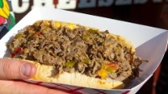
United States
What does staple food mean in the US?
Back to Map
Notes:
What does "staple food" mean in American society? Since the United States is a country of multilateral immigrants, I think many people eat their ethnicity. So, there will be no "staple food" that works throughout the United States like this in other parts of the world. But many foods are stable for Americans. You may get the point with the food in the video.

